Slide 1

Megaminx
MMR 2020 – Group 3

Slide 2
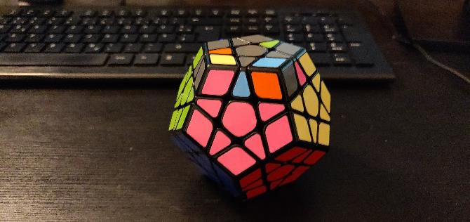
Goals
Reminder: Goal 112

Slide 3
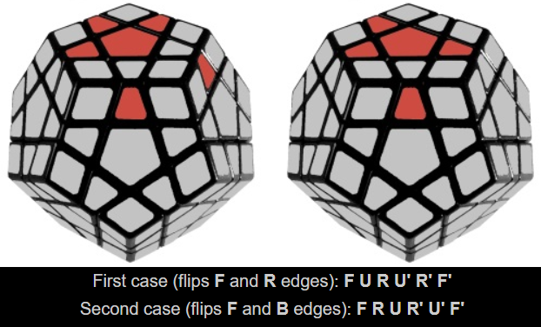
ALGORITHMS
SP10
SP11

Slide 4
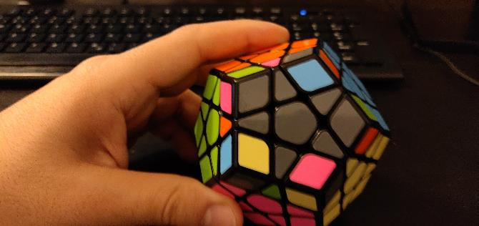
Goals
Goal 113
Moves: u, sp10, sp11
Note: Ignore the lower layers and only program the grey star and its corresponding edges

Slide 5
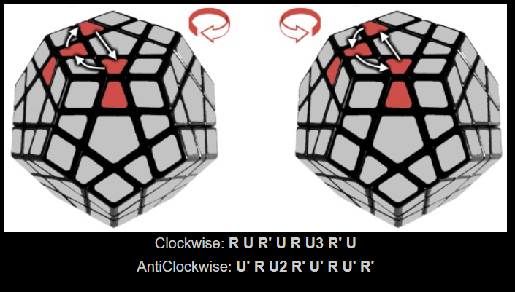
ALGORITHMS
SP12
SP13

Slide 6
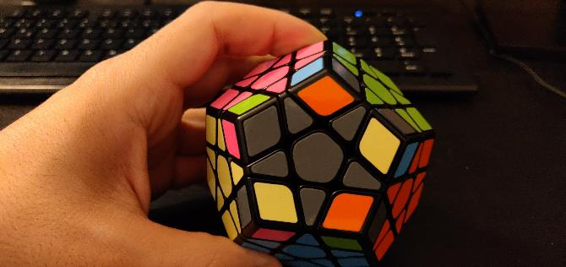
Goals
Goal 114
Moves: u, sp12, sp13
Note: Ignore the lower layers and only program the grey face and its corresponding edges and corners

Slide 7
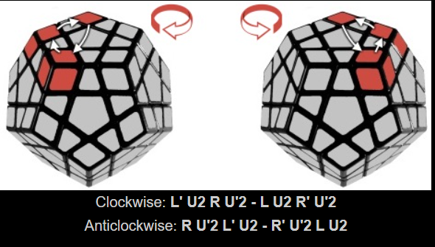
ALGORITHMS
SP14
SP15

Slide 8
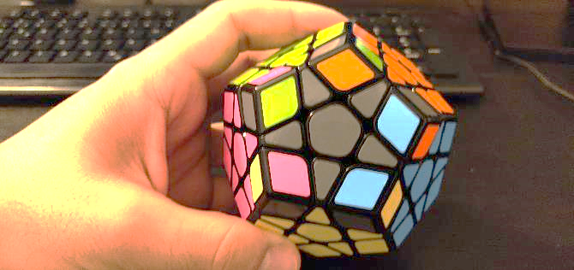
Goals
Goal 115
Moves: u, sp14, sp15
Note: Ignore the lower layers and only program the grey face and its corresponding edges and corners

Slide 9
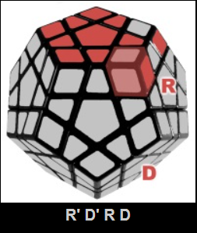
SP16

Slide 10
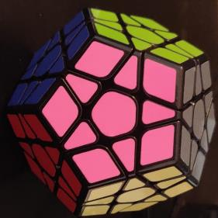
Goals
Goal 116
Moves: u, sp16

